Slide 1
Become a better C# Developer
Kathleen Dollard
.NET Languages PM, Microsoft
Notes:
Prep notes: Turn off Code Lens

Slide 2
You’re an intermediate to advanced C# …
We’ll start by stepping back to look at new technology. Will AI change the way you code, why does C# seem to move so fast, and why is it still so hard to write tests.
Then we’ll dive into C# details that will help you write more reliable code – including overloads, details of basic types and conversions, and functions as first-class citizens in LINQ and elsewhere. The details you’ll see are not niche cases, but aspects of the kind of C# code you use every day and you’ll learn to avoid mistakes and create more reliable code.
We’ll look more deeply at the last five years in C# evolution and how code today can better express your intent and will almost certainly be faster than older code. You’ll watch an application evolve, showing how to apply techniques like records and pattern matching.
You’ll leave ready to apply what you’ve learned to your own code assets.

Slide 3






Slide 4

Notes:
Wondering why you are doing this?

Slide 5



Slide 6

Notes:
Do you think it used to be easier?

Slide 7
The day…
Opening – a bit about learning and some puzzles
Dive into patterns
Types – including records
More puzzles and closing
As part of the closing, I will ask you what you remember from the day
(and I will really need someone to type for me)
Remembering what we covered helps you learn, and
This gives you a file you can refer back to.

Slide 8
Puzzle
Would this code pass your review?
context.cs

Slide 9

I don’t have the one missing piece of the puzzle

Slide 10

I can help untangle things

Slide 11

This icon for things to think about

Slide 12

We are all in this together Your strongest assets are the people around you

Slide 13




Slide 14
The first session…
A bit about me
Learning
Skills vs knowledge
Depth of Knowledge
Peer learning
Teaching to deepen knowledge
Learning via mistakes

Slide 15
First programmed in Jr. High
Hated computers
when mistakes were not free
Many languages,
many dialects
Fascinated about how people use computer languages

Slide 17







Collaboration
Debugging
Profiling
Skills
IDE/tools
Communicating
Generally, learn by repetition
You sometimes do without thinking
Tend to have a long shelf life
Skills and knowledge are both important, but you get them differently
Balance
Typing
Knowledge
Notes:
10 minutes

Slide 18
Depth of Knowledge (Webb or Bloomberg)
Creating
Expertise
Evaluating
Analyzing
Competency
Applying
Understanding
Background knowledge
Remembering
Notes:
VB6 Dan Appleman and Bruce McKinney

Slide 19
Expertise is not the goal for all things
Expertise
Competency
Background knowledge

Slide 20
Your organization is not well served if everyone has the same level of knowledge in all the things you use

Slide 21
Expertise is not the goal for all things
Expertise
Competency
Background knowledge

Slide 22
How do we get there  and stay there ?
 Lots of varied experience
Increasing time per increment
Increased awareness of how much to learn
Expertise
 Study and experience
 Reasonable effort for new knowledge, Often with confidence
Competency
 Building and refining mental models
Reasonable effort for new knowledge
Overwhelmed
Background knowledge
Notes:
20 min mark

Slide 23
Expertise
Key technique: Approach problems from many directions, creativity is key
Biggest challenge: Finding good feedback and discussion and increasing investment/learning ratio
Best tip: Articulating ideas and answering questions while teaching broadens your perspective

Slide 24
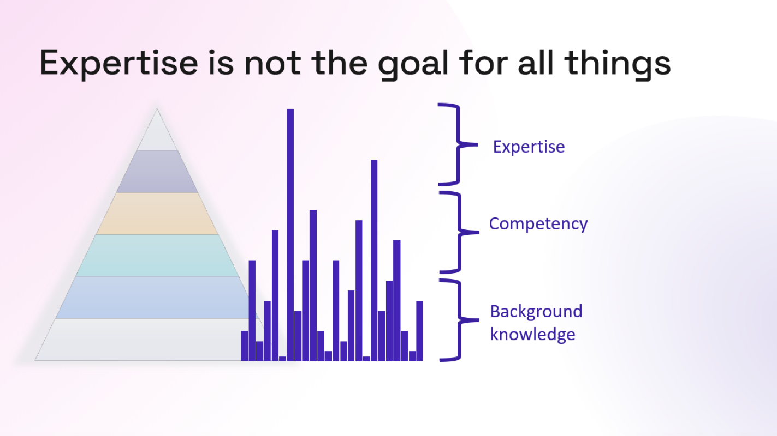
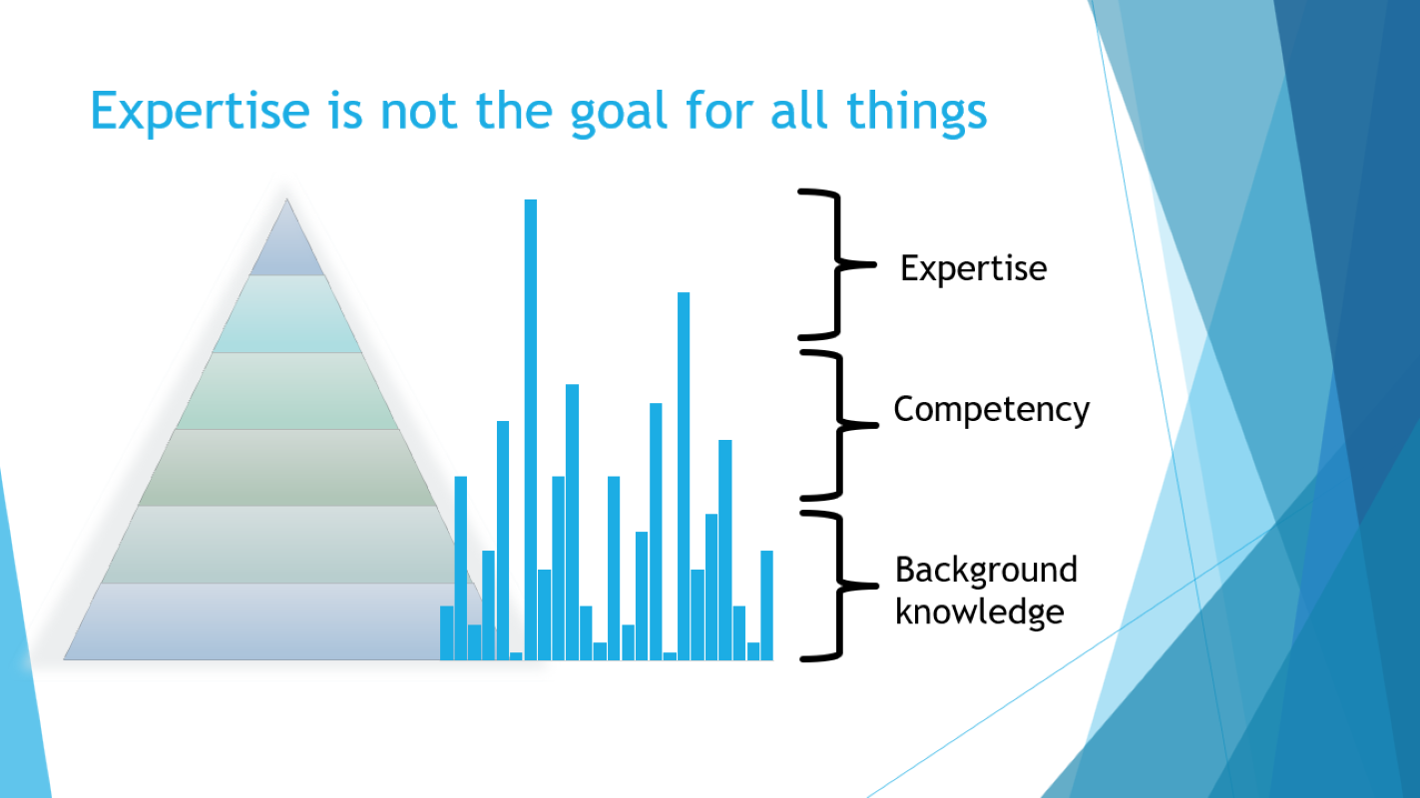
Consider where to have general knowledge, competency or strive for expertise in each area you are thinking and learning about
Remember
You are not alone
Good resources are incredibly valuable

Slide 25
Competency
Key technique: Repetition, asking questions, code review
Biggest challenge: Finding enough time to expand knowledge
Best tip: Don’t be afraid to ask questions

Slide 26
Competency lets you do your job effectively
There’s no badge and finished, you are always pushing
You can still make mistakes, if they are caught. Analyzers!
This is what the rest of the day is all about!
Notes:
30 minutes

Slide 27
General knowledge
Key technique: Build and refine a mental model
Biggest challenge: Finding up to date and reliable resources
Best tip: Have several friends who can answer questions and confirm understanding

Slide 28
A bit about cognitive search
This section draws heavily from the article: From zero to - nearly - hero with Azure OpenAI NLP and vector-based search in Azure Cognitive Search - Microsoft Community Hub
Example for general knowledge
This is explicitly a simplified view

Slide 29
I am Kathleen Dollard, .NET Languages Program Manager
["I",
" am",
" Kath",
"leen",
" Doll",
"ard",
",",
" .",
"NET",
" Languages",
" Program",
" Manager",
"."]
"I" - Pronoun
"am" - Verb
"Kathleen" - Noun
"Dollard" - Noun
"," - Punctuation
".NET" - Noun
"Languages" - Noun
"Program" - Noun
"Manager" - Noun
"." (period): Punctuation
"I" - Pronoun
"am" - Verb be (Lemmatization)
"Kathleen Dollard" - Entity (NER/Named Entity Recognition)
"," - Punctuation
".NET" - Noun
"Languages" - Noun
"Program Manager" - Entity (NER/Named Entity Recognition)
"." (period): Punctuation
Tokenization
A visualization

Slide 30
"I" - Pronoun
"am" - Verb be (Lemmatization)
"Kathleen Dollard" - Entity (Named Entity Recognition/NER)
"," - Punctuation
".NET" - Noun
"Languages" - Noun
"Program Manager" - Entity (Named Entity Recognition/NER)
"." (period): Punctuation
Magic!
Stuff experts understand
[0.00164756608373814752,
-0.00647566083738147523,
0.00566083738147521647,
…
Total of 1536 values,
Which makes a very big vector
Embedding
Encoding into vectors

Slide 31
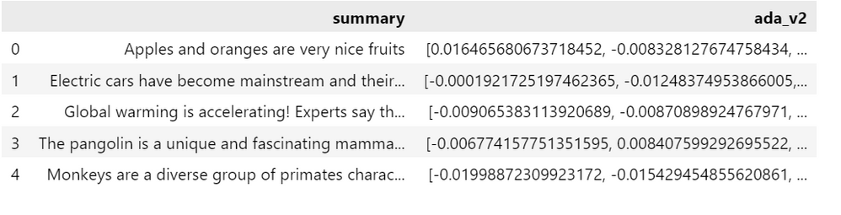
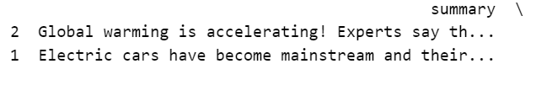
"I'm looking for information about climate change?"
Turn input into numbers
Compare vectors - example cosine similarity
Take the top two

Slide 32
Context is important
Short text does not lead to semantically good vectors
Chat cannot by itself
Tell you what day it is
Use past answers for future questions
Know relevant data
AI engineering adds context, samples, limits, etc.

Slide 33
Glossary
Large Language Models (LLM): Chat
Data frame: 2D table whose columns can contain many types of data
Tokenization: splitting text into small units to be processed
Hallucinations: model returns result that is not true
Embeddings: extracting features from raw data
Prompt/Prompt Engineering: preprocessing input and supplying context or samples to improve Chat results
Polyglot Notebooks: like Jupyter notebooks but supports many languages
Notes:
35 minutes

Slide 34
What will you do with AI?
I do not know the impact of AI and worry about it recreating the past,
but I believe it will be better if good devs that understand apps lead

Slide 35

Puzzles!
In just a bit

Slide 36
Teaching to deepen learning

Slide 37

The most important resource here are those sitting next to you, and those you have lunch with

Slide 38
When you get home, consider doing a Lunch and Learn on something you saw here at DevIntersection

Slide 39
Learning via mistakes

Slide 40



Newton’s third Law of motion
A freight train hits a tiny (unoccupied) car going the same speed
Does the car or train exert more force on the other?

Slide 41
Two videos
Traditional
“If you think this, you are wrong because…”
“Great video, really well presented”
“Loved it”
Before/after testing showed statistical difference in…
Students with wrong answers were more confident in them
“Terrible video, very confusing”
“Hated it”
Before/after testing showed statistical difference in…
Students did better – more right answers

Slide 42
Commit/articulate, so you know you are wrong
Programming is a domain of correct and incorrect results
Your bias systems cause you to twist what you hear to meet your previous views
The easiest way to break through your bias is to explicitly face what right and wrong answers – which requires you know what your answer (specifically) was
Today, you will pair up and explain the result you expect and why
I call this explicit incorrectness

Slide 43
Peer learning

Slide 44
Apparently, you think I know what I am doing
Math students tend to learn more when they work in problems as a group than when a teacher lectures the answers
Teachers understand likely wrong routes and ask questions to guide students
You likely process what your peers say differently than what a trusted expert say
This may be because the unceertainty and the desire to contribute, mean you are thinking more accurately
Learning is not being a sponge
We do not have master teachers, so need to rely on explicit incorectness

Slide 45
Puzzles!

Slide 46

Resources
AI stuff
.NET Conf: Maria Naggaga Nakanwagi and Luis Quintanilla Build Intelligent Apps with .NET and Azure | .NET Conf 2023 – YouTube
https:aka.ms/ai-dotnet-learn
Cognitive search/LLM/Chat
To understand NLP: From zero to - nearly - hero with Azure OpenAI NLP and vector-based search in Azure Cognitive Search - Microsoft Community Hub, Stephane Eyskens
An example aimed at coders: Demystifying Retrieval Augmented Generation with .NET - .NET Blog (microsoft.com)

